Slide 1
DO ≈ 2–3 mg/L band
Wastewater Treatment Aeration Tank Control Using PER-DQN and Rule Extraction
Selected Topics in Artificial Intelligence | 7th Project
Mariam Eladawy 231000469 · Nourallah Ghonim 231003800
Jaslim Elmassry 231012500 · Zeyna Nader 231000000
Notes:
SAY: A simulation study: DQN and PER-DQN blower controllers for a single aeration tank, compared with fixed and rule-based control, with SHAP and decision-tree rule extraction. It is NOT a validated real-plant controller.
CONFIRM: university, instructor, academic year, and Zeyna Nader's student ID (231000000 looks like a placeholder).
Q: Is this a real plant? A: No; a simplified simulator driven by BSM1-derived influent.
Q: One-line result? A: DQN and PER-DQN are close; the rule-based controller protects DO far better; no PER-DQN superiority is claimed.

Slide 2
The idea: choose blower power so oxygen stays in band at low energy
PROJECT IDEA
Blower u ∈ {0, 25, 50, 75, 100}%
DO sensor
Aeration tank
Air lets microbes consume organic pollutants.
Dissolved oxygen (DO)
O₂ in water (mg/L). Too low harms treatment; too high wastes energy.
Influent: flow Q, BOD proxy
BOD proxy
COD-derived: 0.6·(Ss+Xs). Not measured BOD.
AI controller
Picks a blower level every 15 min.
Notes:
SAY: Microbes in the aeration tank remove organic pollution and need dissolved oxygen (DO, mg/L) from blowers. BOD is the oxygen demand of the organic load; here it is a COD-derived PROXY, 0.6 x (Ss+Xs), not measured BOD. Our AI picks one of five blower levels every 15 minutes. Energy is a normalized proxy (u squared), not kWh.
Q: Why 2–3 mg/L? A: Our illustrative target band; not a regulatory claim.
Q: Why is BOD not measured BOD? A: It is computed from BSM1 Ss and Xs fractions using an assumed factor 0.6; no lab BOD exists in the data.

Slide 3
Objectives and the oxygen–energy trade-off
PROJECT IDEA
1 Maintain adequate dissolved oxygen
Oxygen (DO band)
2 Reduce aeration energy (proxy)
3 Handle changing influent conditions
4 Compare fixed, rule-based and RL control
Treatment (BOD proxy)
Energy proxy u²
5 Explain decisions with SHAP and rules
AI balances all three
Notes:
SAY: Five goals: keep DO in band, cut aeration energy, cope with changing influent, compare intelligent vs conventional control, explain the AI. More air raises DO but costs energy; less air saves energy but DO drops. The reward encodes this trade-off.
Q: Is treatment performance measured? A: Only through the simulated DO band and a BOD proxy; there is no effluent-quality measurement.
Q: Are objectives weighted equally? A: No; weights are reward design choices (slide 8).

Slide 4
Related work and our contribution
LITERATURE REVIEW
Study | Algorithm(s) | Setting | Key finding (abstract-level)
Croll et al. 2023 | DQN, PPO, A2C, TD3 | BSM1-type control | TD3 −14.3% energy; DQN generally poor
Klawikowska 2024 | TD3 | BSM1, 4 weather scenarios | Better aeration-energy efficiency and cost
Zhu et al. 2025 | Bayesian opt. + RL | Activated sludge (A2O) | −46% cost, −12% energy, compliant
Zhang et al. 2026 | SAC, TD3, PPO | MLP surrogate, 227 records | RL beat proportional dosing control
This project | DQN, PER-DQN | Simplified tank + BSM1-derived influent | PER-DQN ≈ DQN; rule-based best on low DO
Contribution: a transparent testbed isolating PER vs uniform replay (matched seeds), benchmarked against fixed and rule-based control, with SHAP and extracted rules — reported honestly, including the neutral result.
Foundations: Mnih 2015 · van Hasselt 2016 · Schaul 2016 · Lundberg & Lee 2017 · Bastani 2018
Notes:
SAY: Croll et al. (2023): of DQN, PPO, A2C and TD3 on BSM1-type control, TD3 cut aeration+pumping energy 14.3%; DQN generally performed poorly. Klawikowska & Grochowski (2024, IEEE Access): TD3 on BSM1, four weather scenarios. Zhu et al. (2025): Bayesian optimization + RL, 46% lower cost, 12% lower energy. Zhang et al. (2026, Processes 14(11):1800): model-based SAC/TD3/PPO for chemical dosing on a surrogate of 227 plant records. Results are not comparable across papers.
Foundations: DQN (Mnih 2015), Double DQN (van Hasselt 2016), PER (Schaul 2016), SHAP (Lundberg & Lee 2017), tree extraction (Bastani 2018).
GAP: we did not find a verified 2025–26 PER-DQN aeration paper; we do not claim none exists.
Q: Novelty? A: A transparent, reproducible testbed with a matched DQN vs PER comparison and honest reporting, plus XAI.
Q: Why DQN if Croll found it weak? A: Our task is small and discrete; DQN is a fair baseline.

Slide 5
Data pipeline and BSM1 verification
PROPOSED APPROACH
BSM1 raw files
1,345 × 15
Verify vs official
copy (1,344 rows)
Proxy + flow
0.6(Ss+Xs); Q/24
Chronological
split 70/15/15
Simulator input
one row / 15 min
Check | Dry | Rain | Storm
Columns matched (of 10 examined) | 10 | 9 | 9
Differing column | — | Si (unused) | Si (unused)
Ss, Xs, Q matched | Yes | Yes | Yes
Dry, rain and storm test partitions are identical → no independent weather generalization.
Real (BSM1-derived): flow Q, BOD proxy input
Simulated: DO, BOD proxy state, blower response
Train 70% · 941
Val 15% · 202
Test 15% · 202
Sampling: 15 min · 14 days · same row counts in all three scenarios
Notes:
SAY: Raw IWA BSM1 influent (dry, rain, storm): 1,345 rows x 15 columns each, 15-minute sampling over 14 days. We compared the first 1,344 rows with an official BSM1 distribution: dry matched in 10/10 examined columns; rain and storm in 9/10. Only Si differed, and Si is not used. Ss, Xs and Q matched. Preprocessing: bod_in_proxy = 0.6(Ss+Xs); flow = Q/24 (m3/h). Chronological split per scenario: train 941 / validation 202 / test 202 rows.
CRITICAL: the dry, rain and storm TEST partitions are identical, so they cannot show independent weather generalization.
DISTINCTION: influent = BSM1-derived data; DO, BOD proxy and blower response = simulated.
Q: Why 0.6? A: An assumed COD-to-BOD style factor, not calibrated.
Q: Did the Si difference matter? A: No; Si is not an input.

Slide 6
Single-tank simulation model (illustrative, not BSM1/ASM1)
PROPOSED APPROACH
D = Q / V
dilution rate (1/h)
r_{bio} = k_{b} · BOD · DO / (K_{O} + DO)
oxygen-limited degradation
dBOD/dt = D(BOD_{in} − BOD) − r_{bio}
organic-load proxy
dDO/dt = K_{La}·u·(DO_{sat} − DO) − 0.5·r_{bio} + D(DO_{in} − DO)
aeration, consumption, inflow
x_{t+1} = clip(x_{t} + 0.25 h · dx/dt)
Euler step, bounded states
Illustrative simulation only — not calibrated or validated against real plant data.
Notes:
SAY: One well-mixed tank. Dilution D=Q/V. Biodegradation r = k_b·BOD·DO/(K_O+DO). BOD changes with inflow dilution minus degradation; DO changes with aeration K_La·u·(DO_sat−DO), minus oxygen used (0.5 per unit BOD degraded), plus inflow dilution. Euler step dt = 0.25 h; 96 steps = 24 h. Parameters: V 1000 m3, k_b 0.08/h, K_O 0.5, K_La,max 2/h, DO_sat 8.
STATUS: equations are from the repository snapshot whose checkpoints reproduce your verified results exactly; confirm they match the final wastewater_env.py.
NOT calibrated or validated against plant measurements.
Q: Why simplified? A: Transparency and speed for RL experiments; ASM1 is future work.
Q: Is DO realistic? A: Only qualitatively; no calibration.

Slide 7
Markov decision process
PROPOSED APPROACH
Agent
Q-network 5→128→128→5
Action a ∈ {0, 25, 50, 75, 100}%
Environment
tank simulator +
BSM1-derived influent
γ = 0.99
96 steps = 24 h
Δt = 15 min
Reward r and next state s′
S state
A action
R reward
S′ next state
DO, BOD, previous blower, influent BOD proxy, flow
5 discrete blower settings
DO band, organic proxy, energy, switching
Tank update + next 15-min row
Notes:
SAY: State: DO, BOD proxy, previous blower, influent BOD proxy, flow (5 numbers, scaled by fixed constants). Action: 5 blower levels. Reward: penalties on DO, organic proxy, energy, switching. Next state: Euler update plus the next 15-minute influent row. 96 steps per episode; time-limit truncation, no terminal state; gamma 0.99.
Q: Is it truly Markov? A: Approximately; the agent sees only the current influent row, no forecast.
Q: Why previous blower in the state? A: It enters the switching penalty.

Slide 8
Reward function
PROPOSED APPROACH
r = −[ 12·max(0, 2−DO′)² + 5·max(0, DO′−3)² + 0.1·min(4, (max(0, BOD′−30)/30)²) + u² + 0.1·|u − u_{prev}| ]
Term | Weight | Threshold | Purpose
Low DO | 12 | DO < 2.0 | protect treatment
High DO | 5 | DO > 3.0 | avoid over-aeration
Organic proxy (capped) | 0.1 | 30 mg/L, cap 4 | illustrative limit
Energy u² | 1.0 | — | normalized proxy
Switching | 0.1 | |u − u_prev| | smooth control
Example case | Blower | DO′ | Reward
Blower too low (0%) (DO 2.1) | 0% | 0.673 | -21.565
Appropriate (50%) (DO 2.1) | 50% | 2.149 | -0.65
Too high (100%) (DO 2.9) | 100% | 3.776 | -4.464
The capped organic-proxy term is ≈ −0.38 per step for every controller (BOD proxy stays far above 30 mg/L), so it does not distinguish controllers.
Pending your confirmation
Notes:
SAY: r = −(12·max(0,2−DO')² + 5·max(0,DO'−3)² + 0.1·min(4,(max(0,BOD'−30)/30)²) + 1.0·u² + 0.1·|u−u_prev|). Low DO is penalized most; high DO and energy discourage over-aeration; switching discourages chattering; the BOD term is capped.
EXAMPLES (computed with the environment, BOD 130): blower 0% from DO 2.1 → DO 0.67, reward −21.6; blower 50% → DO 2.15, reward −0.65; blower 100% from DO 2.9 → DO 3.78, reward −4.46.
KEY INSIGHT: the capped BOD term is ≈ −0.38 per step (≈ −37 per episode) for every controller, so it does not separate controllers; energy dominates reward gaps.
STATUS: weights from the repository snapshot; confirm they are your final reward settings.
Q: How were weights chosen? A: Design choice; no sensitivity analysis — a limitation.

Slide 9
Deep Q-Network (DQN)
PROPOSED APPROACH
Q(s,a) ← Q(s,a) + α [ r + γ max_{a′} Q(s′,a′) − Q(s,a) ]
5 state
inputs
128
ReLU
128
ReLU
5 Q-
values
y = r + γ · Q_{θ⁻}( s′, argmax_{a′} Q_{θ}(s′,a′) )
L(θ) = E[ Huber( y − Q_{θ}(s,a) ) ]
Component | Setting
Replay buffer / batch | 50,000 / 64
Exploration | ε-greedy, final ε = 0.05
Optimizer | Adam, lr 5e-4, γ = 0.99
Target network | sync every 250 updates
Pending your confirmation
Notes:
SAY: Q(s,a) is the expected discounted return. A network (5→128→128→5, ReLU) approximates it. Replay breaks correlation; epsilon-greedy explores (1.0 → 0.05, final epsilon 0.05); a target network, synced periodically, stabilizes bootstrapping. The code uses a Double-DQN target (online net picks the action, target net evaluates it) and Huber loss.
STATUS: hyperparameters (lr 5e-4, batch 64, buffer 50,000, sync every 250 updates) are from the repository snapshot; confirm.
Q: Why a target network? A: A moving target makes bootstrapped regression unstable.
Q: Is it vanilla DQN? A: It is DQN with a Double-DQN target.

Slide 10
Prioritized Experience Replay (PER-DQN)
PROPOSED APPROACH
δ_{i} = y_{i} − Q_{θ}(s_{i}, a_{i}), p_{i} = |δ_{i}| + 10⁻⁵
Schematic (not data)
Uniform sampling
P(i) = p_{i}^{α} / Σ_{k} p_{k}^{α}, α = 0.6
w_{i} = (N · P(i))^{−β} / max_{j} w_{j}, β: 0.4 → 1.0
 | Uniform (DQN) | Prioritized (PER-DQN)
Sampling | equal | ∝ |TD error|^0.6
Loss weights | all 1 | importance weights
Everything else | identical | identical
Prioritized sampling
Pending your confirmation
Notes:
SAY: Uniform replay samples every stored transition equally. PER samples transitions with larger TD error more often. delta = y − Q(s,a); p = |delta| + 1e-5; P(i) = p^alpha / sum p^alpha (alpha 0.6); importance weights w = (N·P(i))^(−beta) / max w with beta annealed 0.4 → 1.0 correct the sampling bias. New transitions get maximum priority.
STATUS: alpha, beta and the O(N) list sampling are from the repository snapshot; confirm.
Q: Why might PER not help? A: Untested hypotheses: small 5-D state space, stationary simulator, noisy TD errors, untuned alpha/beta.
Q: What does beta do? A: Controls how fully sampling bias is corrected.

Slide 11
Training: large improvement, but no proven plateau
PROPOSED APPROACH
Mean reward | DQN | PER-DQN
First 100 episodes | −656.22 | −657.81
Last 100 episodes | −100.06 | −99.98
Improvement | +556.16 | +557.82
Late SD across seeds | 1.95 | 2.45
Rewards were still improving in the last window: a stable convergence plateau was not demonstrated. No claim that PER-DQN converged faster.
600 episodes · seeds 42/43/44 · 6 checkpoints · final ε = 0.05
Notes:
SAY: 600 episodes per model, seeds 42, 43, 44, trained on dry training data (6 checkpoints), final epsilon 0.05. Mean reward: first 100 episodes DQN −656.22, PER-DQN −657.81; last 100 episodes −100.06 and −99.98; improvement +556.16 and +557.82; across-seed late-reward SD 1.95 and 2.45.
INTERPRETATION: both learned a lot and agree across seeds. Rewards were STILL improving in the final window, so a stable convergence plateau was not demonstrated, and we do not claim PER-DQN converged faster.
WHY IMPROVING REWARD IS NOT CONVERGENCE: training reward includes epsilon-random actions; a rising curve means learning is ongoing, while convergence needs a flat, stable curve over a long window (or longer runs).
Q: Does PER learn faster? A: Not shown; the curves nearly coincide.
Q: Why not train longer? A: Time; it is listed as future work.

Slide 12
DQN vs PER-DQN on the held-out dry test
RESULTS AND DISCUSSION
Metric (mean over 3 model seeds) | DQN | PER-DQN
Mean reward | −61.461 | −62.348
Low DO (%) | 14.583 | 14.132
High DO (%) | 2.396 | 4.931
Energy proxy | 22.891 | 23.694
Blower switches | 25.70 | 25.40
Reward SD across seeds | 0.693 | 0.732
Small differences, significance not demonstrated. DQN: better reward and energy. PER-DQN: fewer low-DO steps. No overall PER-DQN win.
Notes:
SAY: Chronological dry test; 20 episodes per model seed; evaluation seed 900; averages over model seeds 42, 43, 44. DQN: reward −61.461, low-DO 14.583%, high-DO 2.396%, energy 22.891, switches 25.70. PER-DQN: −62.348, 14.132%, 4.931%, 23.694, 25.40. Across-seed reward SD: 0.693 (DQN), 0.732 (PER-DQN).
INTERPRETATION: DQN slightly better on reward and energy; PER-DQN slightly fewer low-DO steps but more high-DO. Differences are small (reward gap ≈ 0.9, about one seed SD) and significance was NOT tested. Never claim PER-DQN is better.
WHY PER-DQN DID NOT CLEARLY WIN (hypotheses, untested): low-dimensional state, stationary simulator and a modest buffer leave little to prioritize; TD errors are noisy; alpha/beta untuned; only 3 seeds.
Q: Is DQN significantly better? A: No test was done; with 3 seeds we call it descriptive.
Q: Is 14.13 vs 14.58 meaningful? A: No; it is tiny.

Slide 13
Controller comparison on the held-out dry test
RESULTS AND DISCUSSION
Controller | Reward | Low DO % | High DO % | Energy | Switches
Fixed 50% | −95.903 | 23.802 | 23.021 | 24.000 | 0.00
Fixed 75% | −415.419 | 0.000 | 86.771 | 54.000 | 0.00
Rule-based | −65.202 | 3.802 | 4.896 | 26.750 | 18.95
DQN | −61.461 | 14.583 | 2.396 | 22.891 | 25.70
PER-DQN | −62.348 | 14.132 | 4.931 | 23.694 | 25.40
Best reward/energy: DQN. Best DO protection among adaptive controllers: rule-based. Fixed 75% is “safe” only at very high cost.
Notes:
SAY: Fixed 75% eliminates low DO (0%) but is above 3 mg/L 86.8% of the time and uses 54.0 energy units. Fixed 50% is cheap (24.0) but low DO 23.8%. The rule-based controller has low DO 3.8% and high DO 4.9% at energy 26.75. DQN/PER-DQN get the best rewards and lowest energy but low DO of 14.6%/14.1%.
Q: Which would you deploy? A: None directly; the rule-based controller is safer on DO here; RL needs constraints and real validation.
Q: Why does RL beat rule-based on reward? A: Lower energy (22.9–23.7 vs 26.75).

Slide 14
Why the rule-based controller has fewer low-DO violations
RESULTS AND DISCUSSION
Reading the chart
Organic-proxy term ≈ 36.7 for all: constant offset.
Energy separates the adaptive controllers (22.9 – 26.8).
Quadratic low-DO penalty makes shallow dips cheap.
Rule-based pays ≈ 17% more energy for 3.8% vs ≈ 14% low DO.
Pending your confirmation
Notes:
SAY: Reward decomposition (penalty per episode, held-out test, seed 900): the organic-proxy term is ≈ 36.7 for every controller, so it cannot separate them. Energy is the largest controllable term: rule 26.8, DQN 22.9, PER 23.7. DO penalties of the learned controllers are small (low DO ≈ 0.8–1.1) because the penalty is quadratic: shallow dips below 2 mg/L cost little. So the agents rationally trade many shallow DO dips for ~15% less energy than the rule-based controller, which actively tracks the 2.5 mg/L target.
IMPLICATION: low-DO behavior is a consequence of reward design, not proof that RL cannot protect DO; a stronger or constraint-style low-DO penalty is future work.
STATUS: decomposition computed by running the repository environment with the checkpoints; confirm reward settings are final.
Q: Is the learned policy unsafe? A: By the DO-violation metric it protects DO less than the rule; it has no safety guarantee.
Q: Could RL match the rule? A: Possibly with a stronger low-DO term; not tested.

Slide 15
Rain and storm event diagnostics (not independent tests)
RESULTS AND DISCUSSION
Low DO % (rain / storm) | Rain | Storm
Rule-based | 3.08 | 3.74
DQN | 23.65 | 19.60
PER-DQN | 20.05 | 21.15
Fixed 50% | 41.39 | 59.03
Windows overlap training/validation data, one model seed: diagnostics only, not independent held-out weather tests. Raw totals are not comparable (389 vs 454 steps).
Energy per step — rain: PER-DQN 0.285, DQN 0.348, rule 0.344 · storm: PER-DQN 0.332, DQN 0.345, rule 0.392
Notes:
SAY: Full-window runs with the dry-trained seed-42 models. Rain: rows 708–1096 (389 steps). Storm: rows 750–1203 (454 steps). Totals — Rain reward / low-DO % / high-DO % / energy: Fixed50 −473.14/41.39/18.25/97.25; Fixed75 −1011.72/0/57.58/218.81; Rule −261.84/3.08/2.31/133.94; DQN −278.81/23.65/9.51/135.38; PER −254.56/20.05/3.34/110.75. Storm: Fixed50 −790.51/59.03/16.52/113.50; Fixed75 −1379.59/1.32/51.10/255.38; Rule −345.48/3.74/2.64/177.94; DQN −337.43/19.60/6.83/156.69; PER −336.05/21.15/6.61/150.56.
The chart normalizes reward per step because the windows differ in length (do not compare raw totals across windows).
INTERPRETATION: PER-DQN had slightly better reward than DQN in both windows and lower energy, but one seed only; the rule-based controller kept low DO at 3–4% vs ≈ 20–24%.
WHY THESE DO NOT PROVE GENERALIZATION: the windows overlap training/validation rows, use one model seed, and the held-out test partitions of all scenarios are identical.
Q: Does PER-DQN generalize better? A: Not shown; one seed, overlapping data.
Q: Why per-step? A: 389 vs 454 steps.

Slide 16
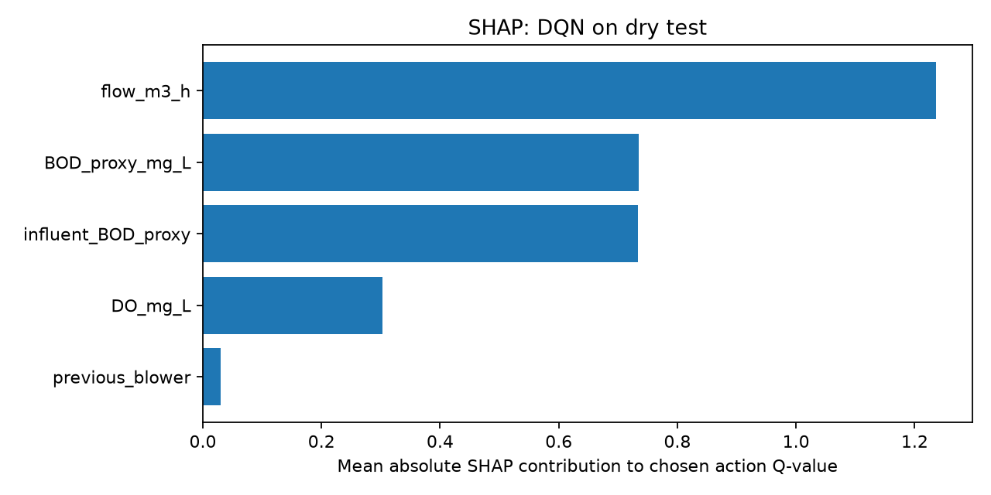
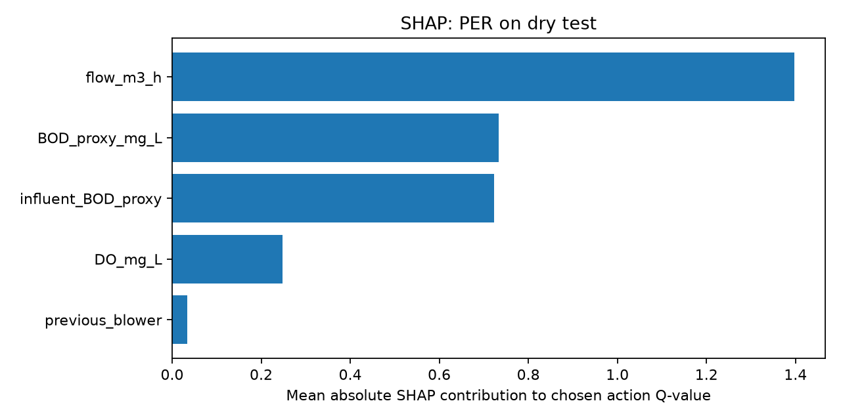
Explainable AI 1/2: SHAP attributions of Q-values
PROPOSED SOLUTION
DQN (seed 42)
PER-DQN (seed 42)
SHAP attributes predicted Q-values of the chosen action to the 5 state features.
It is an explanation of the model, not proof of causality or safe control.
Pending your confirmation
Notes:
SAY: SHAP assigns each input a Shapley-value contribution to the Q-value of the greedy action (KernelExplainer on the Q-network). The figures show mean |SHAP| for seed-42 models explained on dry test rollouts.
STATUS: PENDING — these are outputs from the repository snapshot; confirm they are your final SHAP results (I did not re-run SHAP). Do not quote rankings until confirmed.
CAUTION: SHAP explains what drives predicted Q-VALUES; it is not causal proof and not a safety argument. Seed 42 only; small explained sample.
Q: Why KernelSHAP? A: Model-agnostic.
Q: Does high SHAP mean causal? A: No.

Slide 17
Explainable AI 2/2: surrogate decision-tree rules
PROPOSED SOLUTION
Trained
DQN / PER-DQN
State → action
rollouts
Decision tree
depth 4
IF–THEN
rules
Fidelity
evaluation
PER-DQN rules (seed 42)
IF BOD ≤ 168.6 AND DO ≤ 3.14 AND BOD ≤ 74.6 → 25%
IF BOD ≤ 168.6 AND DO ≤ 3.14 AND BOD > 74.6 → 50%
IF BOD ≤ 168.6 AND DO > 3.14 AND influent BOD ≤ 94.7 → 0%
IF BOD > 168.6 AND DO ≤ 2.47 → 75%
IF BOD > 168.6 AND DO > 2.47 AND influent BOD ≤ 193.4 → 50%
IF BOD > 168.6 AND DO > 2.47 AND influent BOD > 193.4 → 75%
The tree approximates the learned controller’s decisions; it does not guarantee safe control.
Pending your confirmation
Notes:
SAY: We roll out the trained greedy policy, record (state, action) pairs, and fit a depth-4 decision tree (min 20 samples per leaf) to imitate it; rules are read from the tree. Fidelity = agreement with the network on held-out rollouts. Re-derived from the seed-42 checkpoints: DQN fidelity 85.24% (majority baseline 82.38%, balanced 56.87%); PER-DQN 93.49% (majority 89.84%, balanced 61.76%).
CAUTION: fidelity is only a few points above the majority-action baseline, and rare actions are poorly captured. The tree approximates the learned controller; it does NOT guarantee safe control.
STATUS: PENDING confirmation that these are your final XAI outputs.
Q: Are these safety rules? A: No; they describe the network.
Q: Why is PER fidelity higher? A: Its policy is more concentrated on 50%, so the majority baseline is also higher.

Slide 18
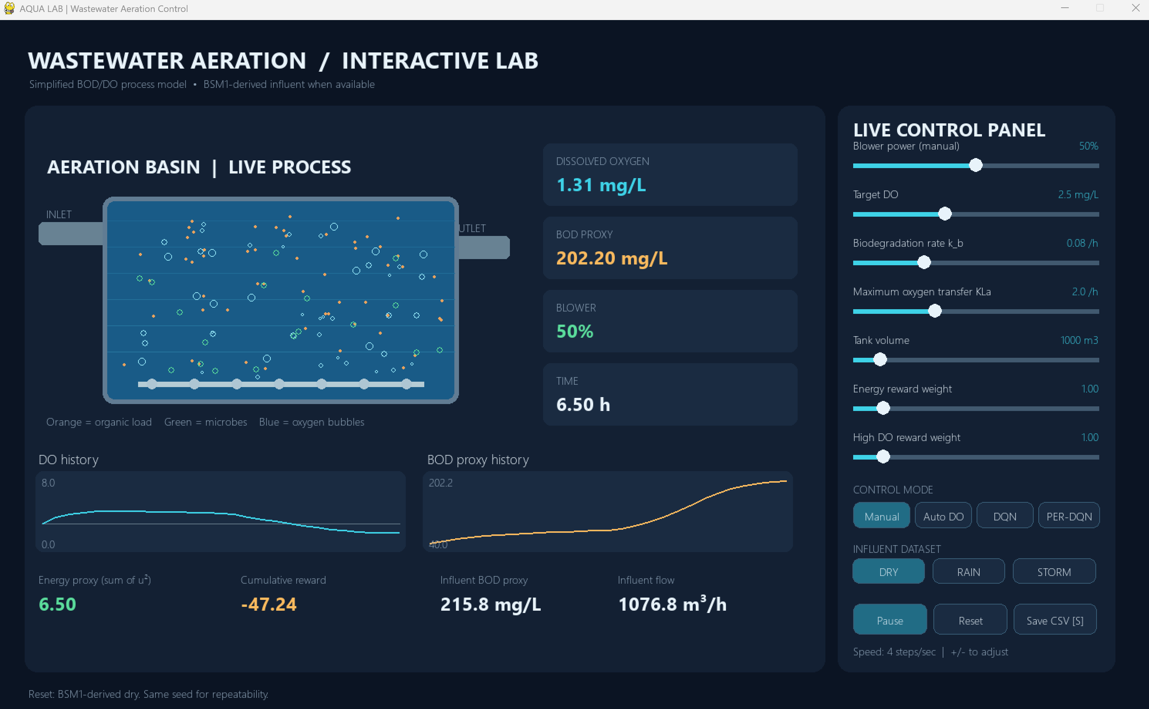
Interactive Pygame aeration lab
PROPOSED SOLUTION
Insert your Pygame screenshot here
(PER-DQN mode, dry influent)
Tank visualization
bubbles ∝ blower, organic load
Controls
Manual · Auto DO · DQN · PER-DQN
Live metrics
DO, BOD proxy, blower, reward, energy
Experiments
dry/rain/storm, sliders, CSV export
Notes:
SAY: The lab shows the animated tank (bubbles scale with blower), live DO, BOD proxy, blower, reward and energy, sliders for blower, target DO and model parameters, four control modes (Manual, Auto DO, DQN, PER-DQN), dry/rain/storm influent, and automatic CSV export of a 24-hour (96-step) episode. AI modes lock sliders to the training configuration.
ACTION: insert your own screenshot in the frame (PER-DQN mode, dry). I did not use a rendered image so that no screenshot is misrepresented.
CAUTION: demo runs are single episodes, not controlled experiments.
Q: Is the demo the evaluation? A: No; evaluation uses the held-out test with fixed seeds.
Q: Why lock sliders for AI? A: The agents were trained on default dynamics.

Slide 19
Limitations and what deployment would require
RESULTS AND DISCUSSION
Limitations
Simplified tank; not calibrated BSM1/ASM1
BOD proxy ≠ measured BOD
Energy proxy u², not kWh
3 seeds; one held-out dry window
Identical test partitions: no independent weather test
Event windows overlap training data
Convergence not demonstrated
RL has 14% low-DO steps vs 3.8% rule-based
Needed before a real plant
Calibrate with measured DO, effluent quality, kWh
Validate on independent plant and weather data
Safety constraints + supervisory fallback
Sensor-fault and disturbance robustness tests
More seeds, statistical testing
Operator and regulatory review
Notes:
SAY: Limitations: simplified single tank, not BSM1/ASM1 and not calibrated; BOD is a COD-derived proxy, not measured BOD, so no effluent-quality claim; energy is u squared, not kWh; only 3 seeds and one held-out dry window; test partitions identical across scenarios; event windows overlap training; convergence not demonstrated; low-DO violations of RL are far higher than the rule-based controller.
BEFORE REAL DEPLOYMENT: calibrate and validate against measured DO, effluent BOD/COD and electricity (kWh); test on independent plant and weather data; add safety constraints and a supervisory layer (hard DO limits, fallback to rule-based control); robustness to sensor faults; more seeds with statistics; operator review.
Q: Why not deploy? A: Simulated, uncalibrated, no safety guarantee.
Q: Is BOD proxy a problem? A: Yes for any treatment claim; it is only a relative load indicator here.

Slide 20
Conclusions and future work
FUTURE WORK
What we can conclude
Both agents improved ≈ +556 reward; no plateau proven
DQN ≈ PER-DQN on held-out test; no superiority claim
Rule-based has far fewer low-DO steps
Event runs are diagnostics, not generalization tests
XAI explains the model; not a safety guarantee
Future work (proposed)
Independent held-out weather events
Longer training to test convergence
Reward redesign / constraint-style low-DO handling
Hyperparameter tuning, more seeds, statistics
ASM1/BSM1-level model, calibrated data
Safe RL and supervisory deployment research
Notes:
SAY: Conclusions are limited to the simulation. 1) Both agents learned strongly (about +556 reward) but convergence was not demonstrated. 2) On the held-out dry test DQN and PER-DQN are close; DQN is slightly better on reward and energy, PER-DQN slightly better on low DO; no significance shown. 3) The rule-based controller protects DO far better. 4) Event diagnostics suggest PER-DQN may do slightly better but are not independent tests. 5) SHAP and tree rules explain but do not make the controller safe.
Q: Main takeaway? A: Reward optimization is not the same as operational safety.
Q: First next step? A: Independent held-out weather events, longer training, stronger low-DO handling, more seeds.

Slide 21
References
REFERENCES
[1] J. Alex, L. Benedetti, J. Copp, K. V. Gernaey, J.-P. Steyer, "Benchmark Simulation Model No. 1 (BSM1)," Lund Univ., Sweden, 2008 (IWA Task Group on Benchmarking).
[2] V. Mnih et al., "Human-level control through deep reinforcement learning," Nature, vol. 518, pp. 529–533, 2015.
[3] H. van Hasselt, A. Guez, D. Silver, "Deep reinforcement learning with double Q-learning," in Proc. AAAI, 2016, pp. 2094–2100.
[4] T. Schaul, J. Quan, I. Antonoglou, D. Silver, "Prioritized experience replay," in Proc. ICLR, 2016, arXiv:1511.05952.
[5] S. M. Lundberg, S.-I. Lee, "A unified approach to interpreting model predictions," in Proc. NeurIPS, 2017, pp. 4765–4774.
[6] O. Bastani, Y. Pu, A. Solar-Lezama, "Verifiable reinforcement learning via policy extraction," in Proc. NeurIPS, 2018.
[7] D. P. Kingma, J. Ba, "Adam: A method for stochastic optimization," in Proc. ICLR, 2015, arXiv:1412.6980.
[8] H. C. Croll, K. Ikuma, S. K. Ong, S. Sarkar, "Systematic performance evaluation of reinforcement learning algorithms applied to wastewater treatment control optimization," Environ. Sci. Technol., vol. 57, no. 46, pp. 18382–18390, 2023.
[9] Z. Klawikowska, M. Grochowski, "Optimizing control of wastewater treatment plant with reinforcement learning: Technical evaluation of twin-delayed deep deterministic policy gradient agent," IEEE Access, vol. 12, pp. 130318–130333, 2024.
[10] Z. Zhu et al., "Bayesian optimization-enhanced reinforcement learning for self-adaptive and multi-objective control of wastewater treatment," Bioresour. Technol., vol. 421, Art. 132210, 2025.
[11] Y. Zhang, D. Meng, W. Ma, "Model-based reinforcement learning for chemical dosing optimization in a municipal wastewater treatment plant," Processes, vol. 14, no. 11, Art. 1800, 2026, doi: 10.3390/pr14111800.
[12] K. Chen et al., "Optimal control towards sustainable wastewater treatment plants based on multi-agent reinforcement learning," Chemosphere, 2021, doi: 10.1016/j.chemosphere.2021.130498.
[13] T. Liu, H. Zhang, J. Wu, W. Liu, Y. Fang, "Wastewater treatment process enhancement based on multi-objective optimization and interpretable machine learning," J. Environ. Manage., vol. 364, Art. 121430, 2024.
[14] A. Durkin et al., "Safe deployment of offline reinforcement learning via input convex action correction," arXiv:2507.22640, 2025 (preprint).
[15] M. Henze, W. Gujer, T. Mino, M. van Loosdrecht, Activated Sludge Models ASM1, ASM2, ASM2d and ASM3, IWA Sci. Tech. Rep. No. 9, 2000.
[16] C. J. C. H. Watkins, P. Dayan, "Q-learning," Mach. Learn., vol. 8, pp. 279–292, 1992.
Notes:
SAY: Do not read the list. Entries [8]–[14] were checked against publisher or arXiv pages during preparation; [1]–[7], [15] and [16] are standard references cited from knowledge — double-check page numbers. Confirm the BSM1 data license/citation (iwa-mia.org/benchmarking).
Q: Any 2025–26 PER paper? A: None verified; PER is cited from Schaul et al. 2016.

Slide 22
SELECTED TOPICS IN ARTIFICIAL INTELLIGENCE
Thank you — Questions?
Wastewater Treatment Aeration Tank Control Using PER-DQN and Rule Extraction
Mariam Eladawy · Nourallah Ghonim · Jaslim Elmassry · Zeyna Nader
GitHub: Nour158/Wastewater-Aeration-PER-DQN
Notes:
SAY: Three honest take-aways: a transparent simulated testbed; DQN ≈ PER-DQN with the rule-based controller far better on DO protection; XAI explains but does not certify safety.
CONFIRM before the defense: university, instructor, year, Zeyna's ID, final reward settings, final SHAP/tree outputs, your Pygame screenshot.
Quick answers: Real plant? No. PER better? Not demonstrated. Converged? Not demonstrated. Independent weather test? No.

